Slide 1

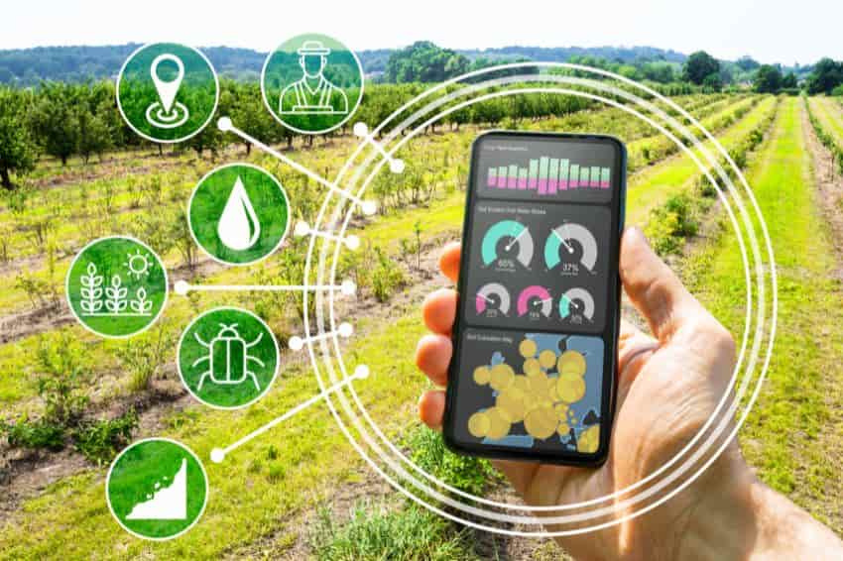

Smart Farm Monitoring System
Project By-
Vishwas Kapoor(12115020)
Vanshika Gandhi(12115037)
Tanisha Goel(12115069)
Project Mentor-
Dr. Ghanapriya Singh
Asst. Professor, ECE Dept.
NIT Kurukshetra

Slide 2
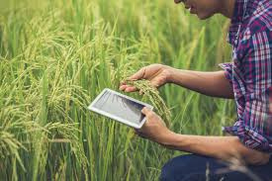


Need for Smart Farming - THE MOTIVATION
Traditional farming relies on manual soil inspection
Leads to inefficient irrigation and water wastage
Large farms have variable conditions across different zones
Rural areas lack reliable internet and power
Need for affordable, power-efficient, and remote monitoring solutions

Slide 3
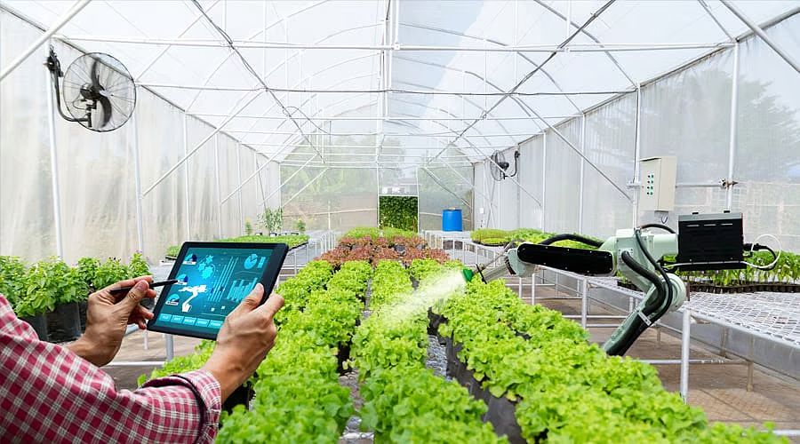

Objective of the Project
Design a wireless system to monitor real-time temperature, humidity, and soil moisture
Implement LoRa-based communication for long-range, low-power data transfer
Focus on efficient power consumption using deep sleep mode and minimal transmissions
Use a microcontroller as an edge device for local sensing and preprocessing
Enable cloud access to data for farmers via a mobile application
Empowering a farmer with data is like giving them the power to predict the future—weather, water, and yield.

Slide 4
Our Solution
We developed a Smart Farm Monitoring System that:
Uses low-cost microcontrollers and sensors
Transmits data via LoRa in remote areas without internet.
Displays data on Blynk mobile app dashboard in real-time.
Focused on low-power, long-range, and scalable design.

Slide 5
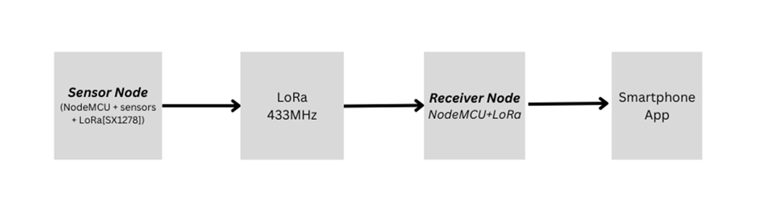
System Architecture
Transmitter Node (Field)
Receiver Node (Base)
Wemos D1 Mini + Sensors (DHT11, Soil Moisture)
SX1278 LoRa Module for wireless data transmission
Powered by a 9V battery + voltage regulator
NodeMCU + SX1278 LoRa Module
Receives data and sends it to Blynk Cloud
Data is viewed on the farmer’s smartphone app
}

Slide 6


Project Components
01
02
03
Sensors
Communication Module
Microcontrollers
DHT11 Sensor
Measures temperature and humidity
Digital output, cost-effective for basic environmental sensing
Capacitive Soil Moisture Sensor
Detects soil moisture level
Analog output, corrosion-resistant design
SX1278 LoRa Module
Enables long-range, low-power wireless communication
Ideal for remote farm locations
Power Supply
9V Battery + LM7805 Regulator
Suitable for outdoor/field deployment
WeMOS D1 Mini
Compact version of ESP8266, used in Wi-Fi-based testing
NodeMCU ESP8266
Main controller for both transmitter and receiver nodes
Built-in Wi-Fi, low-power, Arduino-compatible
04

Slide 7

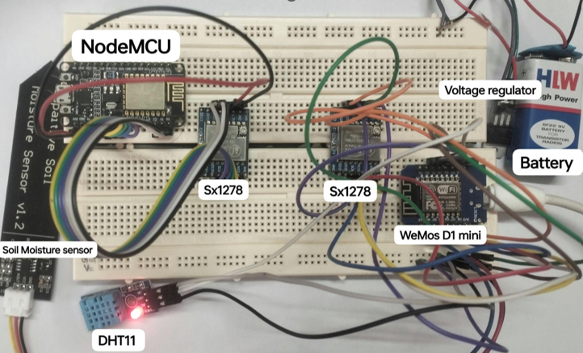
Hardware Setup
The setup uses the WeMos D1 Mini as the transmitter, connected to the DHT11 and soil moisture sensor, powered through a 9V battery regulated to 5V. It collects sensor data and sends it via its SX1278 LoRa module to the NodeMCU receiver, which is also connected to an SX1278 module and forwards the data to the cloud

Slide 8
Pin Connections
Component | Pin on NodeMCU | Pin on SX1278 LoRa Module
MISO | D6 (GPIO12) | MISO
MOSI | D7 (GPIO13) | MOSI
SCK | D5 (GPIO14) | SCK
NSS (CS) | D8 (GPIO15) | NSS (Chip Select)
RESET | D0 (GPIO16) | RESET
DIO0 (Interrupt Pin) | D1 (GPIO5) | DIO0
VCC | 3.3V | VCC
The SPI pins (MISO, MOSI, SCK) connect NodeMCU and LoRa to exchange data.
NSS (Chip Select) tells the LoRa module when the NodeMCU wants to communicate.
RESET lets the NodeMCU reset the LoRa module if needed.
DIO0 is an interrupt pin signaling when transmission or reception is done.
VCC powers the LoRa module with 3.3V from the NodeMCU.

Slide 9
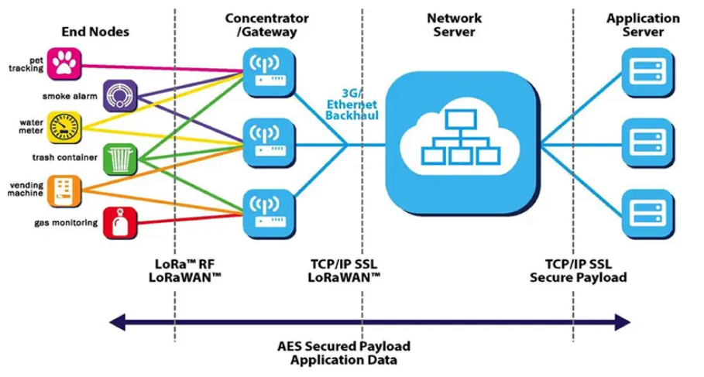
Working of LoRa Communication in Our System
LoRa is a long-range, low-power wireless communication technology.
It uses Chirp Spread Spectrum (CSS) modulation, where signals “chirp” by sweeping frequencies across a wide bandwidth.
CSS helps LoRa to be highly resistant to interference and enables long-distance communication with low power.
Network Components:
Sensors: Collect and send data wirelessly.
Gateways: Receive and forward sensor data.
Network Server: Routes and manages data.
Application Server: Processes data for users.
Data Flow:
Sensor → Gateway → Network Server → Application Server → User

Slide 10


Innovative Approach for Power Consumption
1. Deep Sleep Mode
Microcontroller enters low-power sleep state between readings.
Significantly reduces idle power usage in field deployment.
2. Threshold-Based Transmission
Data is only transmitted when critical values are detected:
e.g., Low soil moisture or high temperature
Reduces unnecessary wireless communication and power drain.
3. Scheduled Sensing
Sensors collect data at fixed intervals (e.g., every 10–15 minutes).
Balances data accuracy with energy efficiency.

Slide 11
Future Scope
1. Automated Irrigation System
Integrate water pumps controlled by sensor data.
Enable automatic irrigation based on soil moisture levels.
2. Solar-Powered Deployment
Replace batteries with solar panels for sustainable power.
Ensure uninterrupted operation in remote areas.
3. Web Dashboard Integration
Develop a centralized platform for large-scale farm monitoring.
Real-time access via desktop and mobile.
4. Expandable Sensor Network
Add sensors for:
Soil pH, light intensity, rainfall, CO₂
Enable a more complete picture of field conditions.

Slide 12
THANK YOU

